Slide 1
Comparison of Missing Data Imputation Methods
By:
Anja Shahu
Ben shea
Mukund Poddar
Nellie ponarul
Rowana ahmed
Saul holding

Slide 2
The Problem
When there is missing data present in longitudinal data:
1) Which imputation method best estimates the missing values (smallest RMSE)?
2) Which imputation method generates the most accurate estimates of average percent change from year-to-year?

Slide 3
Motivation
Reviewed a paper that obtains a confidence interval for a percent change using the Delta Method (Applying the Delta Method in Metric Analytics: A Practical Guide with Novel Ideas - Deng, Knoblich, Lu, 2018)
Wanted to compare the coverage accuracy of this confidence interval for the percent change point estimate with different imputation methods and different missing data mechanisms
Link to Delta Method Paper: https://arxiv.org/abs/1803.06336
Notes:
Fieller's interval of % change is computationally intensive

Slide 4
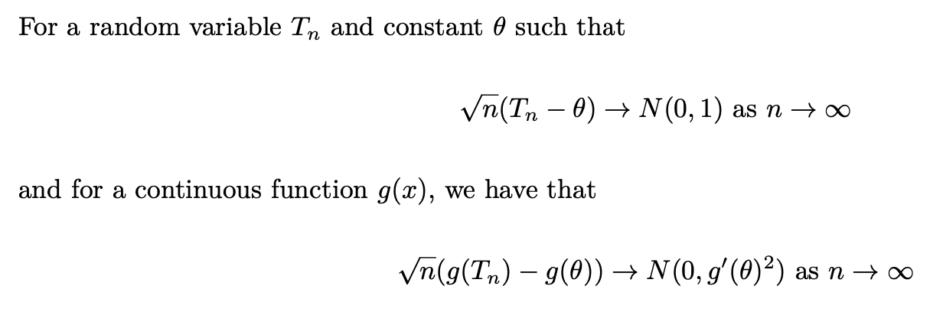
Delta Method

Slide 5
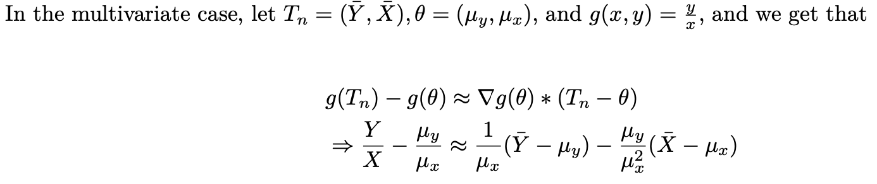
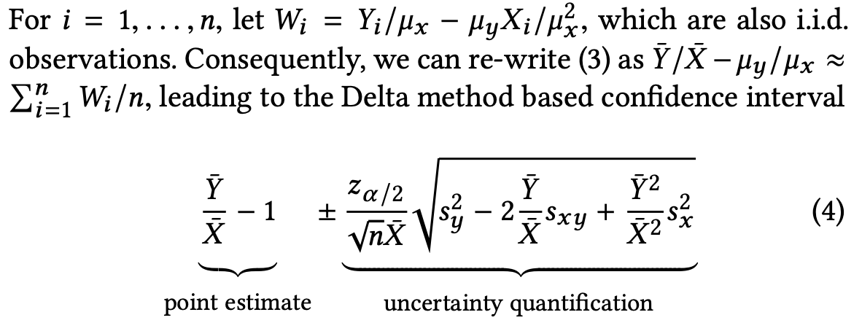
Use Delta Method to get CI for % Change Over Time

Slide 6
Types of Missing Data
Missing Completely at Random (MCAR): failure to observe a value does not depend on any values of y_{i}, either observed or missing, or any other observed values
Missing at Random (MAR): failure to observe a value does not depend on the values of y_{i} which are unobserved, given the observed ones
Missing not at Random (MNAR)*: failure to observe a value depends on the value that would have been observed

Slide 7
Our Dataset
Global Suicide Rates from 1985 to 2016 across 100 countries
(https://www.kaggle.com/russellyates88/suicide-rates-overview-1985-to-2016)
Complete Dataset: created missing data in outcome variable (i.e. suicide rates) in 50 simulations
Missing Completely at Random (MCAR): randomly selected varying percentages of suicide rates across simulations
Missing at Random (MAR): remove varying percentages of suicide rates across simulations but condition on quartiles of GDP for year
45% of total removed suicide rates removed from 1st quartile
30% of total removed rates removed from 2nd quartile
15% of total removed rates removed from 3rd quartile
10% of total removed rates removed from 4th quartile

Slide 8
Imputation Methods
Last Value Carried Forward (LVCF)
Mean Imputation
Generalized Linear Mixed Models (GLMM)
2 variations of K-Nearest Neighbors (KNN)
Predict the Suicide Rate for a given year
Predict the Change in Suicide Rate for a given year

Slide 9
Last Value Carried Forward
Within each level of the clustering variable, impute the missing value at a specific time point with the observed value that occurs immediately before the missing value.
Country | Year | Suicide Rate/100k
U.S. | 2000 | 11.20
U.S. | 2001 | 11.53
U.S. | 2002 | NA
U.S. | 2003 | 11.61

Slide 10
Mean Imputation
Take the mean of the observed values at a specific time point and impute any missing values at the time point with that mean.
Country | Year | Suicide Rate/100k
Australia | 2007 | NA
Germany | 2007 | NA
Republic of Korea | 2007 | NA
Paraguay | 2008 | NA
Republic of Korea | 2008 | NA
Mean | Year
11.04 | 2007
11.40 | 2008

Slide 11
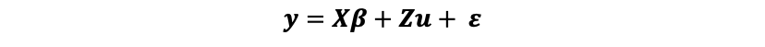
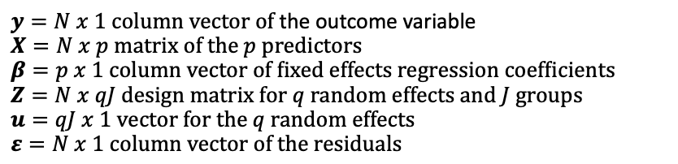
Generalized Linear Mixed Model (GLMM)
Fit with suicide rate as the continuous outcome, year and GDP per capita as the fixed-effects predictors, a fixed intercept and a random intercept for each country to deal with the correlation in suicide rates within countries.
Calculate the predicted suicide rate of the observation based on the model and impute the observation's missing value with the prediction.

Slide 12
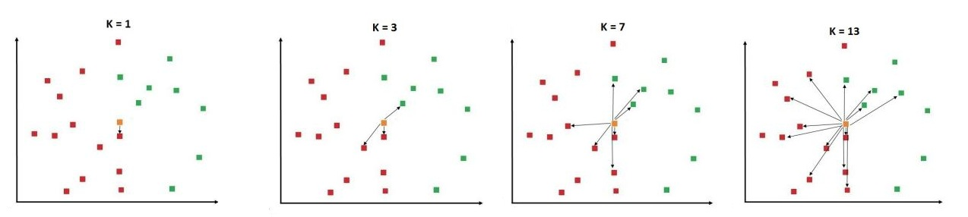
The K Nearest Neighbors (KNN) Method
- Due to the longitudinal aspect of the data, we opted for a KNN Model
- KNN
Non-parametric
Assumes nothing about the underlying data
An algorithm that predicts the response variable based on the K most similar observations based on specified type of distance and weights the nearest neighbors in a specified way to predict the response variable
- Our Analysis
We use the Euclidean distance to find the k nearest neighbors and perform a simple average to predict the missing observations

Slide 13
2 KNN Methods
First Method: After scaling, we subset the missing data from the dataset and use cross validation to tune for the best k nearest neighbors on the suicide rate. Next, with the tuned KNN model, we predict the missing suicide rates.
Second Method: After scaling, we hypothesize that the KNN model can better predict the delta change in the suicide rate based on that year's data. Hence we train the KNN model to take in the missing year's predictors and predict the change in suicide rate. We then add this value to the previous year's absolute number and this value is imputed into the dataset.

Slide 14
Our Simulation
Simulate both MAR and MCAR missing data mechanisms and impute data with various techniques
Create estimates of the percent change of average suicide rates (year over year) using our paper's Delta Method for the different estimates
See which method most accurately captures the true percent change and which method performs the best imputation

Slide 15
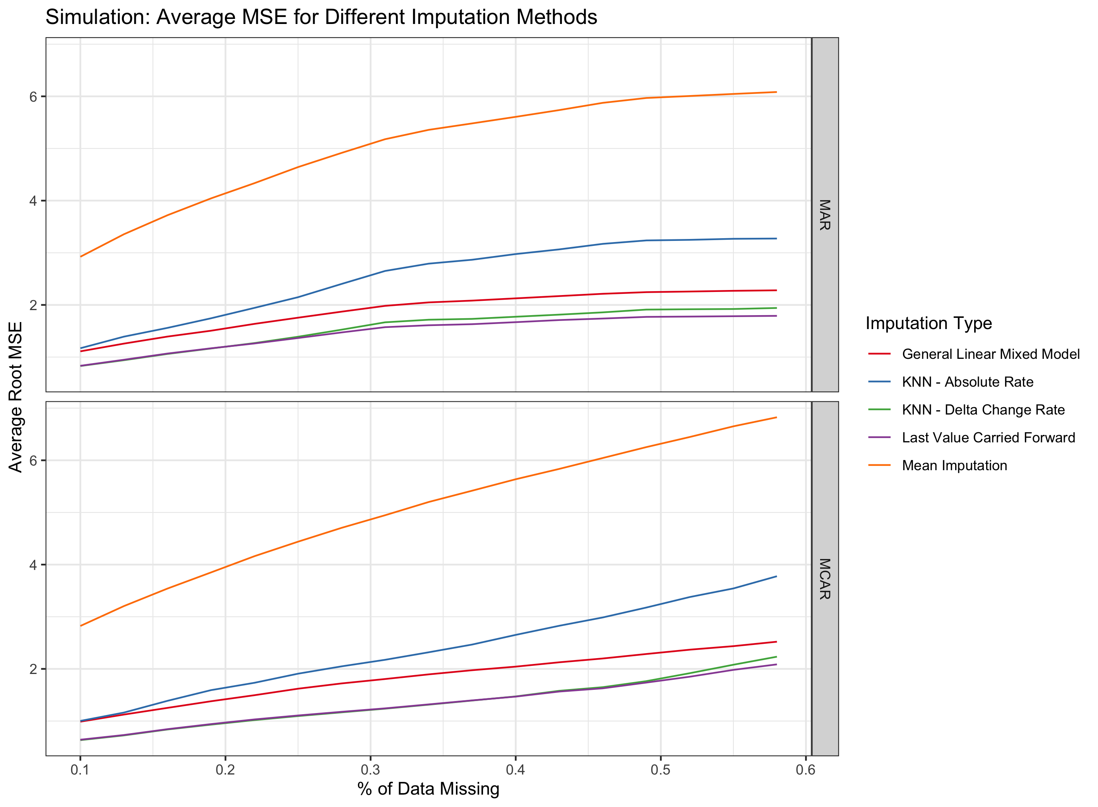
Simulation Results

Slide 16
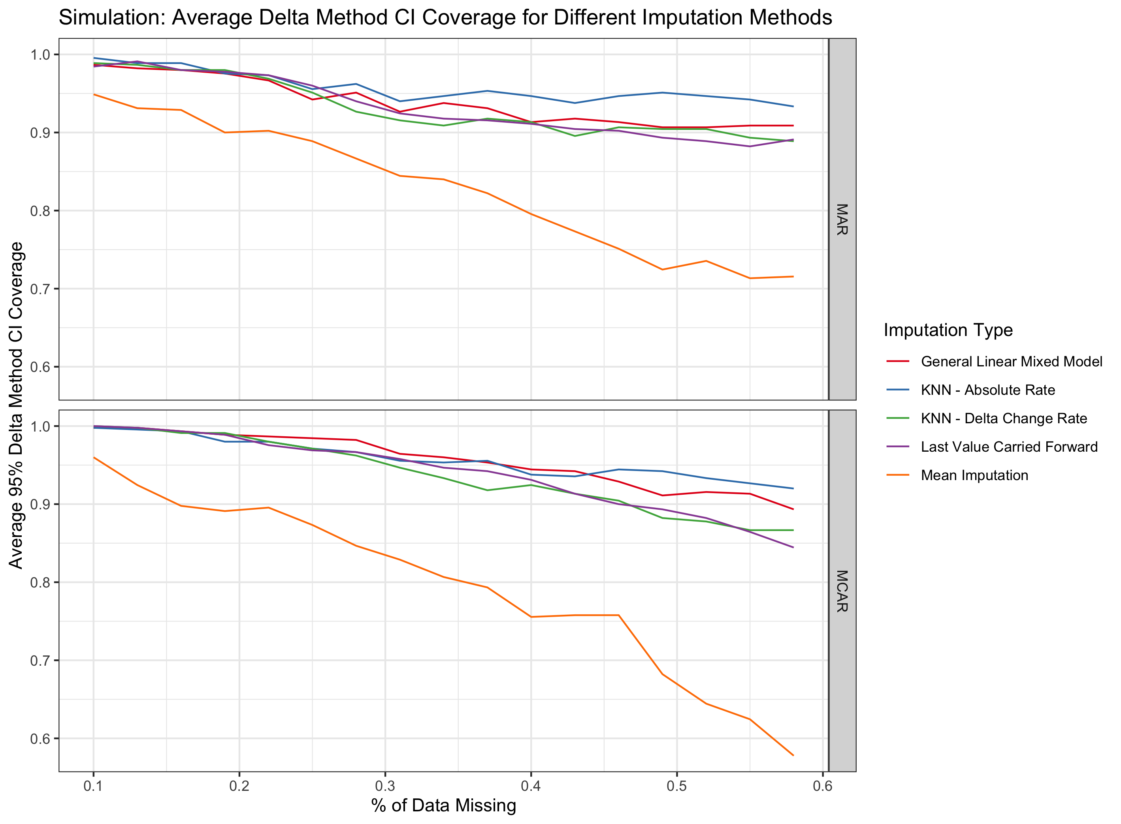
Simulation Results

Slide 17
Conclusion
The RMSE and coverage results for MAR start plateauing with increasing missing data %, while the results for MCAR keep changing. This implies that our models are picking up the missingness pattern implicitly.
Best RMSE:
The Last Value Carried Forward
KNN Delta Change
Best CI Coverage:
KNN Absolute Rate
Last Value Carried Forward performed better than expected – as well as a machine learning algorithm!

